Slide 1
MEANINGFULNESS IN MEASUREMENT

Slide 2
MEANINGFULNESS IN MEASUREMENT
Knowledge of scale type tells us about limitations on the kind of mathematical manipulations that can be performed.
can we deduce meaningful statements about the entities being measured?
Question is harder to answer:
The number of errors discovered during the integration testing of program X was at least 100.
The cost of fixing each error in program X is at least 100.
A semantic error takes twice as long to fix a syntactic error.
A semantic error is twice as complex as a syntactic error.

Slide 3
MEANINGFULNESS IN MEASUREMENT
The number of errors discovered during the integration testing of program X was at least 100.
Meaningful
make sense because the number of errors may be specified without reference to a particular scale
The cost of fixing each error in program X is at least 100.
Not meaningful
the cost of fixing an error cannot be
A semantic error takes twice as long to fix a syntactic error.
Meaningful
Make sense because the ratio of time taken is the same, regardless of the scale of measurement used (hours, seconds, or years to repair).
A semantic error is twice as complex as a syntactic error.
Not meaningful
If “complexity” means time to understand, then the statement makes sense. Otherwise not.

Slide 4
MEANINGFULNESS IN MEASUREMENT
Our intuitive notion of a statement’s meaningfulness involving measurement is quite distinct from the notion of the statement’s truth.
For example,
The President of the United States is 125 years old
the statement is a meaningful statement about the age measure, even though it is clearly false.

Slide 5
MEANINGFULNESS IN MEASUREMENT
meaningfulness in a formal way:
We say that a statement involving measurement is meaningful if its truth value is invariant of transformations of allowable scales
Consider these statements:
Fred is twice as tall as Jane
The measure is in ratio scale, because it uses scalar multiplication as an admissible transformation.
The statement is meaningful because no matter which measure of height we use (inches, feet, centimeters, etc.)

Slide 6
MEANINGFULNESS IN MEASUREMENT
if the statement is true and if M and M’ are different measures of height, then both the statements M(Fred) = 2M(Jane) and M’(Fred) = 2M’(Jane)
are true.
This consistency of truth is due to the relationship
M = aM’
for some positive number a.

Slide 7
MEANINGFULNESS IN MEASUREMENT
The temperature in Tokyo today is twice that in London
This statement also implies ratio scale but is not meaningful
Suppose, that the temperature in Tokyo is 40°C and in London 20°C. Then on the Celsius scale, the statement is true.
However, on the Fahrenheit scale, Tokyo is 104°F while London is 68°F.

Slide 8
MEANINGFULNESS IN MEASUREMENT
The difference in temperature between Tokyo and London today is twice what it was yesterday.
The statement is meaningful, because Fahrenheit and Celsius are related by the affine transformation F = 9/5C + 32, ensuring that ratios of differences (as opposed to just ratios) are preserved.
For example, suppose yesterday’s temperatures on the Celsius scale were 35°C in Tokyo and 25°C (a difference of 10) in London,
while today it is 40°C in Tokyo and 20°C in London (a difference of 20).
In Fahrenheit, yesterday 95°F in Tokyo and 77°F London (a difference of 18); today’s are 104°F in Tokyo and 68°F in London (a difference of 36).

Slide 9
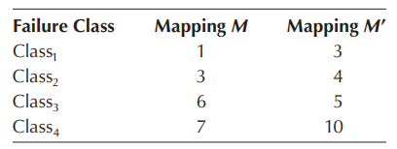
MEANINGFULNESS IN MEASUREMENT
Failure x is twice as critical as failure y
This statement is not meaningful, since we have only an ordinal scale for failure criticality
We can define two mappings, M and M’, to be valid ordinal measures
Suppose y is in class2 and x in class3. Notice that M(x) = 6 and M(y) = 3 while M’(x) = 5 and M’(y) = 4. In this case, the statement is true under M but false under M’.

Slide 10
MEANINGFULNESS IN MEASUREMENT
We want to rank three programs A, B, and C based on speed of software programs
Empirical binary relation faster than
Suppose, empirical relation is such that
A is faster than B, which is faster than C.
This notion of program speed is measurable on an ordinal scale, and, any mapping M in which M(A) > M(B) > M(C) is an acceptable measure.
the statement “Program A is faster than both Programs B and C”
is meaningful.

Slide 11
MEANINGFULNESS IN MEASUREMENT
The statement:
“Program A is more than twice as fast as Program C.”
is not meaningful.
To see why, define acceptable measures M and M’ as follows: M(A) = 3; M(B) = 2; M(C) = 1 M’(A) = 3; M’(B) = 2.5; M’(C) = 2
Using scale M the statement is true, since 3 = M(A) > 2M(C) = 2
However, using M’ the statement is false.
the sophistication of the notion twice as fast was not captured in our over-simplistic empirical relation system, and hence was not preserved by all measurement mappings.

Slide 12
Statistical Operations on Measures
The scale type of a measure aﬀects the types of operations and statistical analyses that can be sensibly applied to the data.
In statistical analyses, we use two basic measures to capture this information: measures of central tendency and measures of dispersion
A measure of central tendency, usually called an average, tells us something about where the “middle” of the set is likely to be, while a measure of dispersion tells us how far the data points stray from the middle.

Slide 13
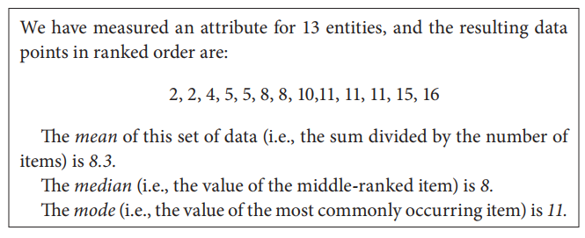
Statistical Operations on Measures
But even these simple analytical techniques cannot be used universally. In particular, nominal and ordinal measures do not permit computation of mean, variance, and standard deviation.
the notion of mean is not meaningful for nominal and ordinal measures

Slide 14
Statistical Operations on Measures
EXAMPLE 2.25 Suppose the data points {x1, …, xn} represent a measure of understandability for each module in system X, while {y1, …, ym} represent the understandability values for each module in system Y.
We would like to know which of the two systems has the higher average understandability. The statement “The average of the x_{i}s is greater than the average of the y_{j}s” must be meaningful; that is, the statement’s truth value should be invariant with respect to the particular measure used.

Slide 15
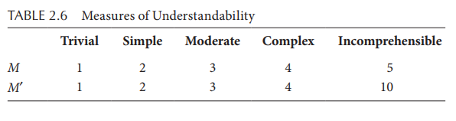
Statistical Operations on Measures
Suppose we assess every module’s understandability according to the following classification: trivial, simple, moderate, complex, and incomprehensible. Here, understandability is representable on an ordinal scale.
we can define two valid measures of understandability, M and M’

Slide 16
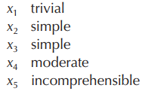
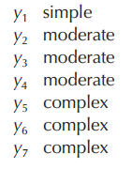
Statistical Operations on Measures
Program X has 5 modules and Program Y has 7 modules
Using M, the mean of the X values is 2.6, while the mean of the Y values is 3.1; thus, the “average” of the Y values is greater than the average of the X values.
However, using M’, the mean of the X values is 3.6, while the mean of the Y values is 3.1. not valid
Since the definition of meaningfulness requires the relation to be preserved, then mean is not a meaningful measure of central tendency for ordinal scale data.

Slide 17
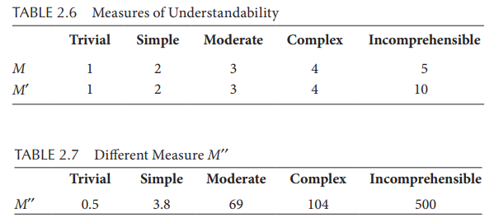
Statistical Operations on Measures
the median (i.e., the middle-ranked item) is a meaningful measure of central tendency. Using both M and M’, the median of the Y values (in both cases 3) is greater than the median of the X values (in both cases 2).
Similarly, if we define M’’ as a radically different measure according to Table 2.7, the median of the Y values, 69, is still greater than the median of the X values, 3.8.

Slide 18
Measurement in Extended Number Systems
In many situations we cannot measure an attribute directly. Instead, we must derive a measure in terms of the more easily understood sub-attributes.
For example, suppose that we wish to assess the quality of the diﬀerent types of transport available for traveling from our home to another city.
Quality can be assessed by sub-attributes, journey time and cost per mile.
Intuitively, given two transport types, A and B, we would rank A superior to B (i.e., A is of higher quality than B) if
journey time (A) < journey time (B) AND cost per mile (A) < cost per mile (B)

Slide 19
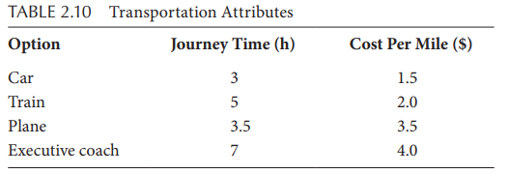
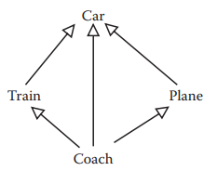
Measurement in Extended Number Systems
Using this rule with the data collected for each journey type, we can depict the relationships among the candidates
Car is superior to both Train and Plane because, in each case, the journey time is shorter and the cost per mile is less.

Slide 20
Measurement in Extended Number Systems
The relation Train and Plane are incomparable; that is, neither is superior to the other.
Additional information is needed.
If cost is more important to us, then Train is preferable; if speed is more important, we would prefer Plane.

